Slide 1
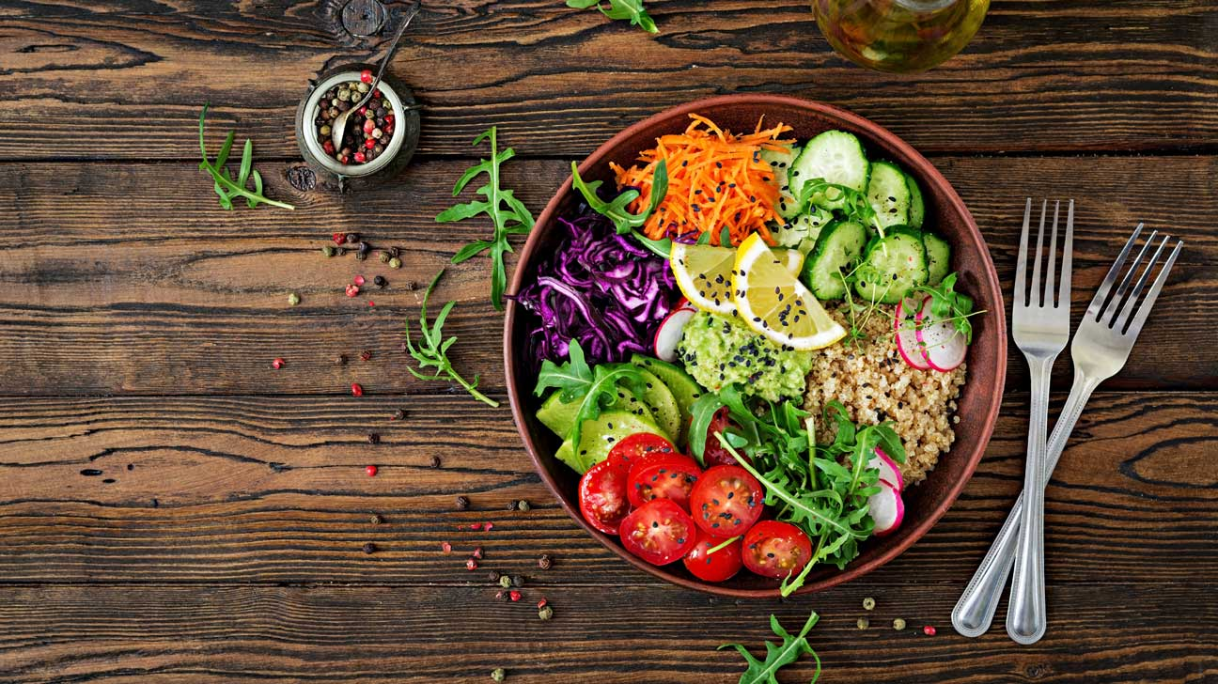
What are the most important topics to vegetarians?
Byunghwa Lee
Nov. 12, 2021

Slide 2

Data
Data retrieved from Twitter
Between 2018– Present
Total Tweet Count: ~ 40K
Topic word “vegetarian”

Slide 3
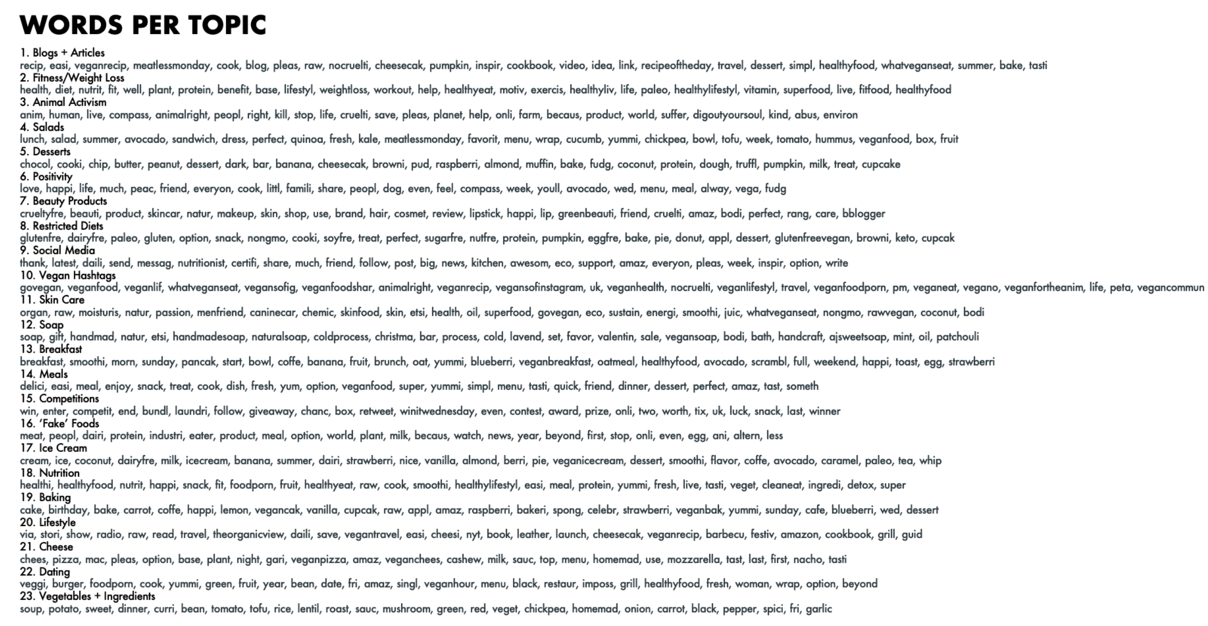
Most common words per topic

Slide 4
3 Main Topics
Food Choices / Eating Habits
Lifestyle Choices / Fitness
Animal Activism

Slide 5
Common words behind the topics
Food
Breakfast – Coffee, Banana, Oatmeal, Toast, Eggs
Fitness , Life Habits
Diet, Fit, Protein, Weight loss, Vitamins, Health
Animal Activism
Human, Animal, Kill, Stop, Cruelty

Slide 6
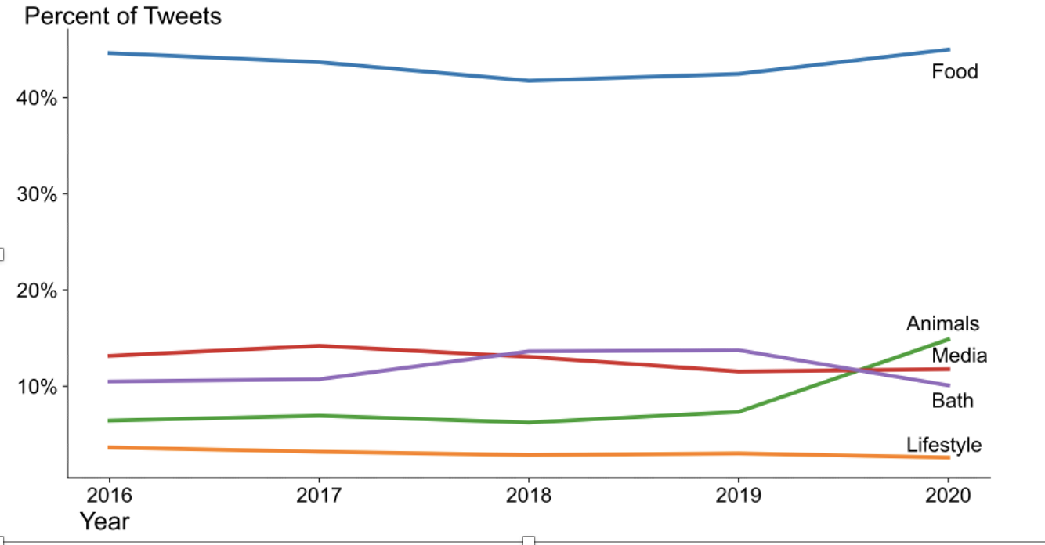
Most discussed Topics

Slide 7
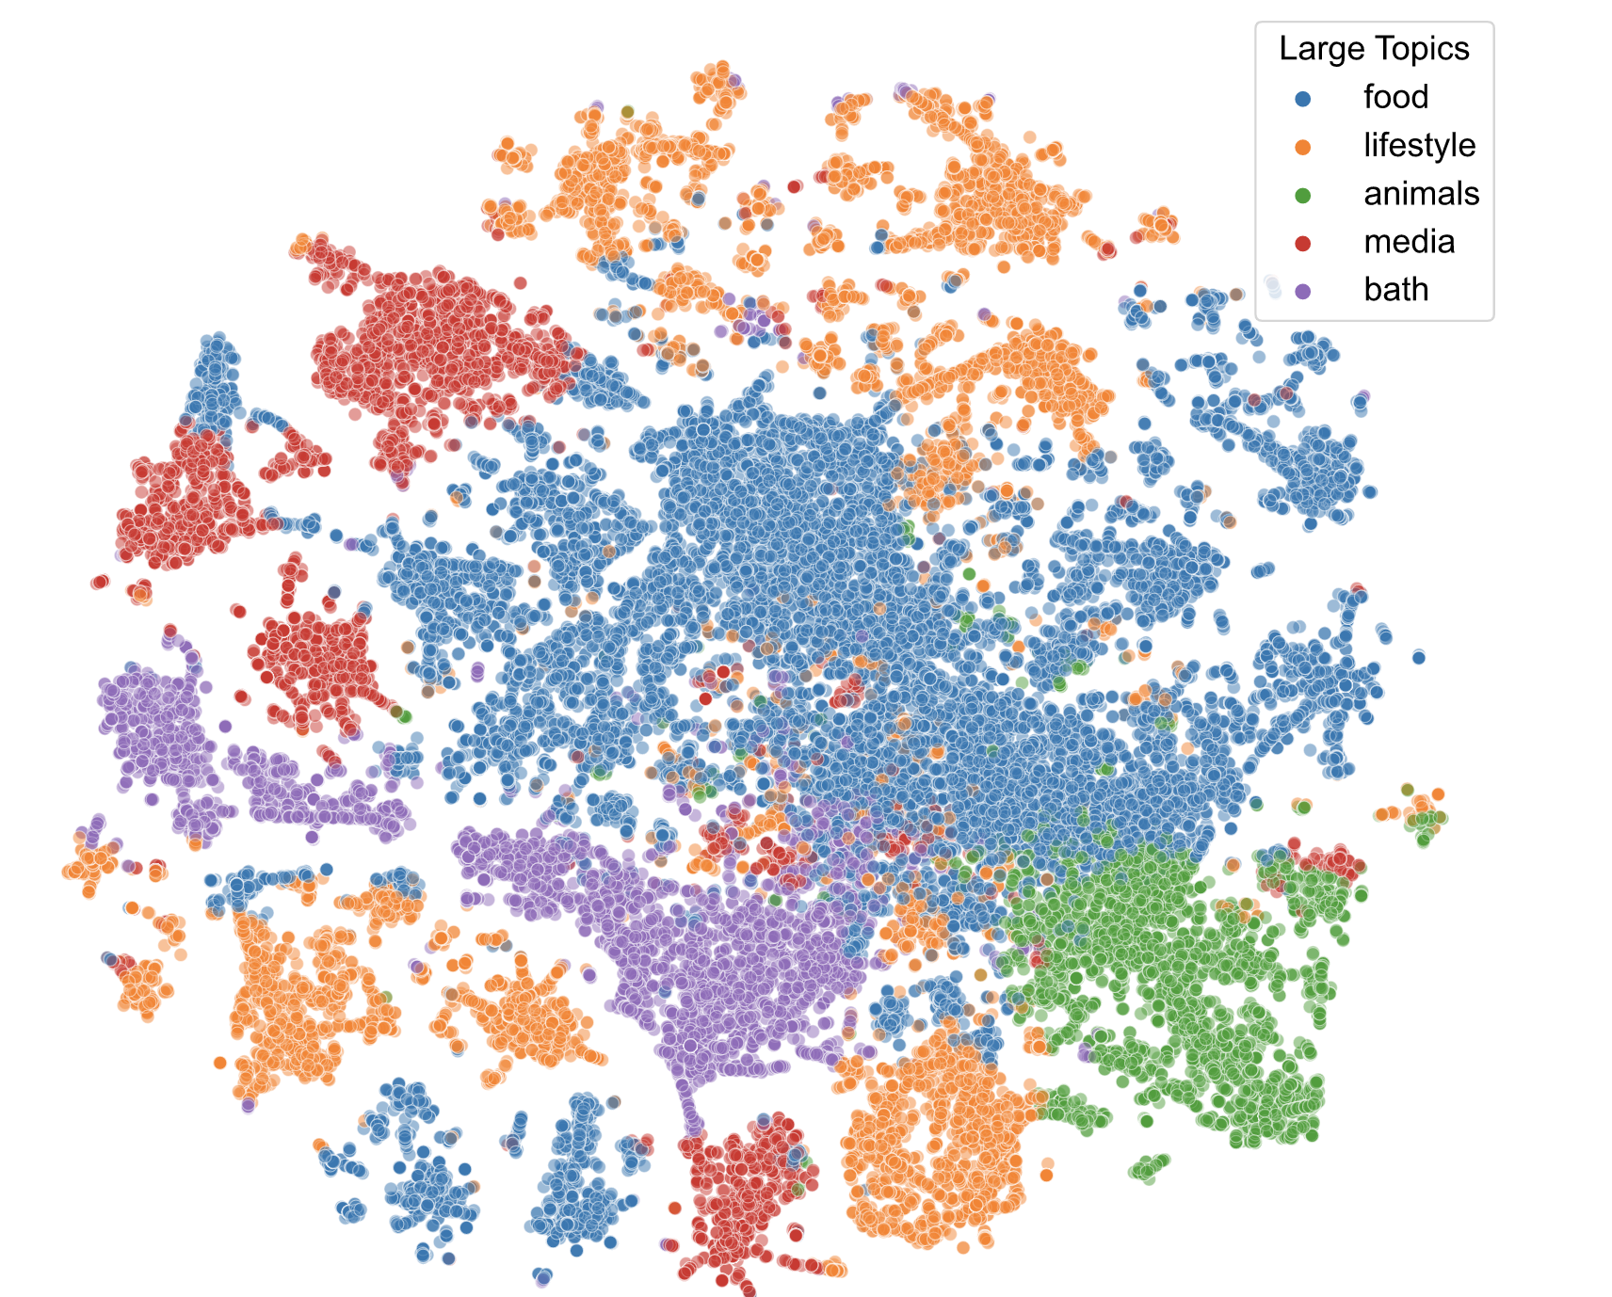
Total Topics

Slide 8
Overall main theme
Food
Average about 47% of total tweets observed discussed about food

Slide 9

Improvements
Find the next growing topic in upcoming years
Deeper insight into subcategories of food
Awareness of the issue

Slide 10
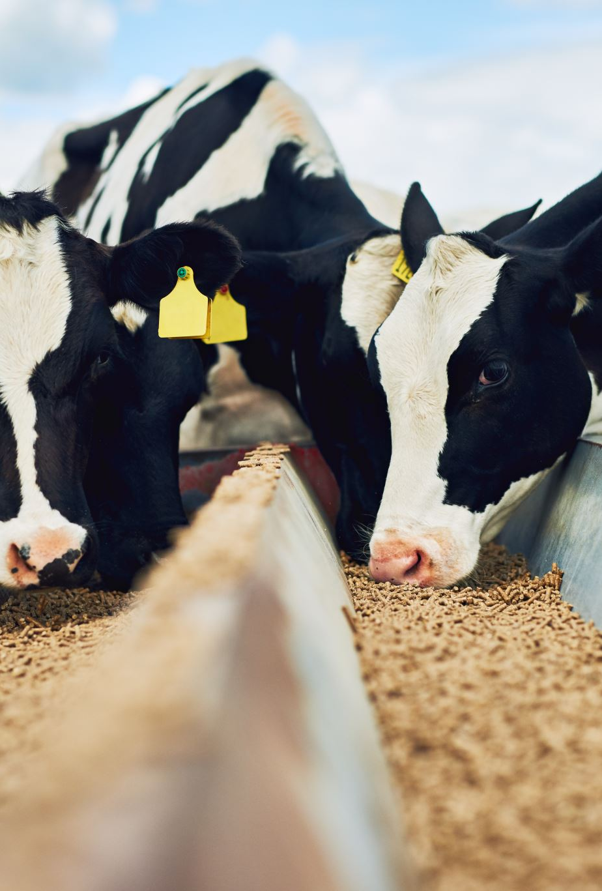
Conclusion
Overall conclusions for vegetarians
Food, lifestyle, animals
Topics stay same over the years
Main concerns are same
Healthy diet -> healthier life!

Slide 11

Thank you!

